Slide 1
Tseccodestorm Hackathon
Problem statement: Digital Citizen Guidence
Team members:
Heeket Mehta
Dhyey Thumar
Jashan Banga
Jay Gala
Team no.:64

Slide 2

So basically we have created a simple but easy to view website. We have provided the options such as Home, NEWS FEED, Nearby Places, Topics, FAQ and Emergency. But we have not created the separate pages for all sections because it will take to much time to load & this type of website should not take much time to load as the user should act fast.
Web view

Slide 3

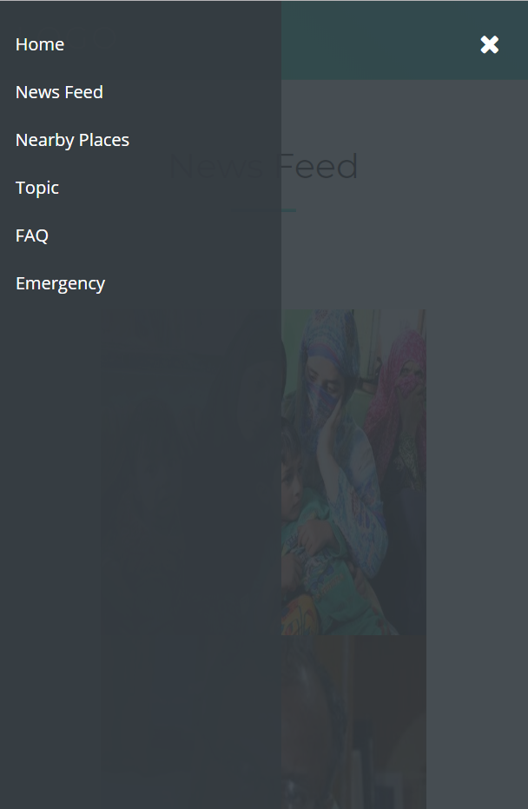
App view

Slide 4
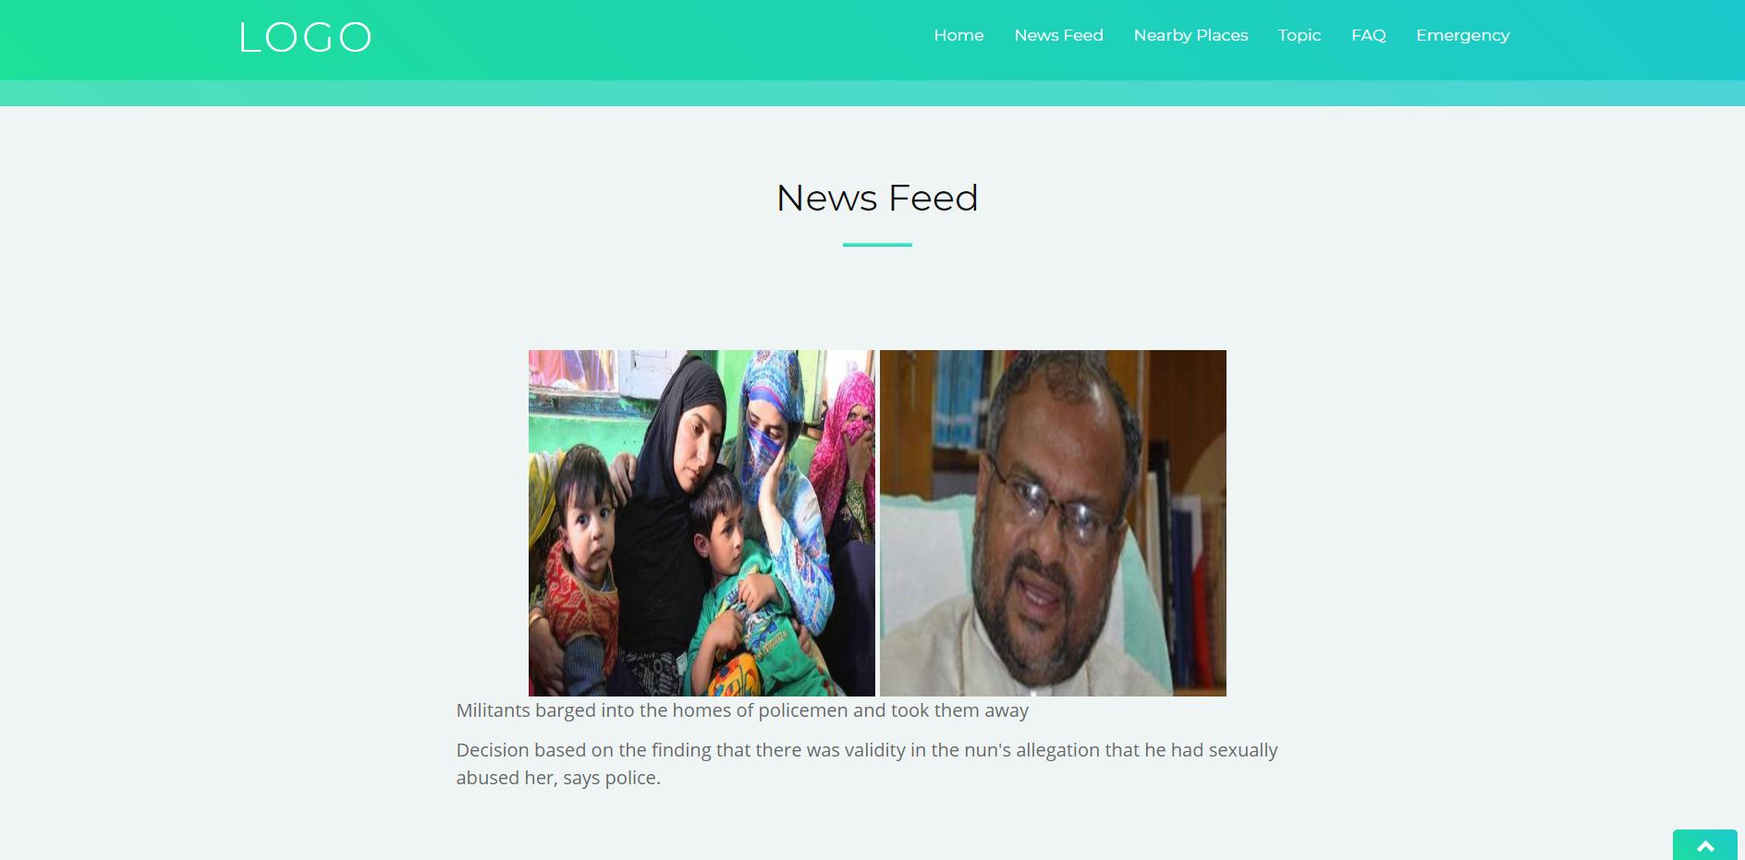
In this section, we have incorporated trending news fields of great concern by making use of an api provided by the hindu. These news feeds are relevant and may draw the attention of the people near the area of mishap, so that they can not only save themselves, but also save those around them.
Web view

Slide 5
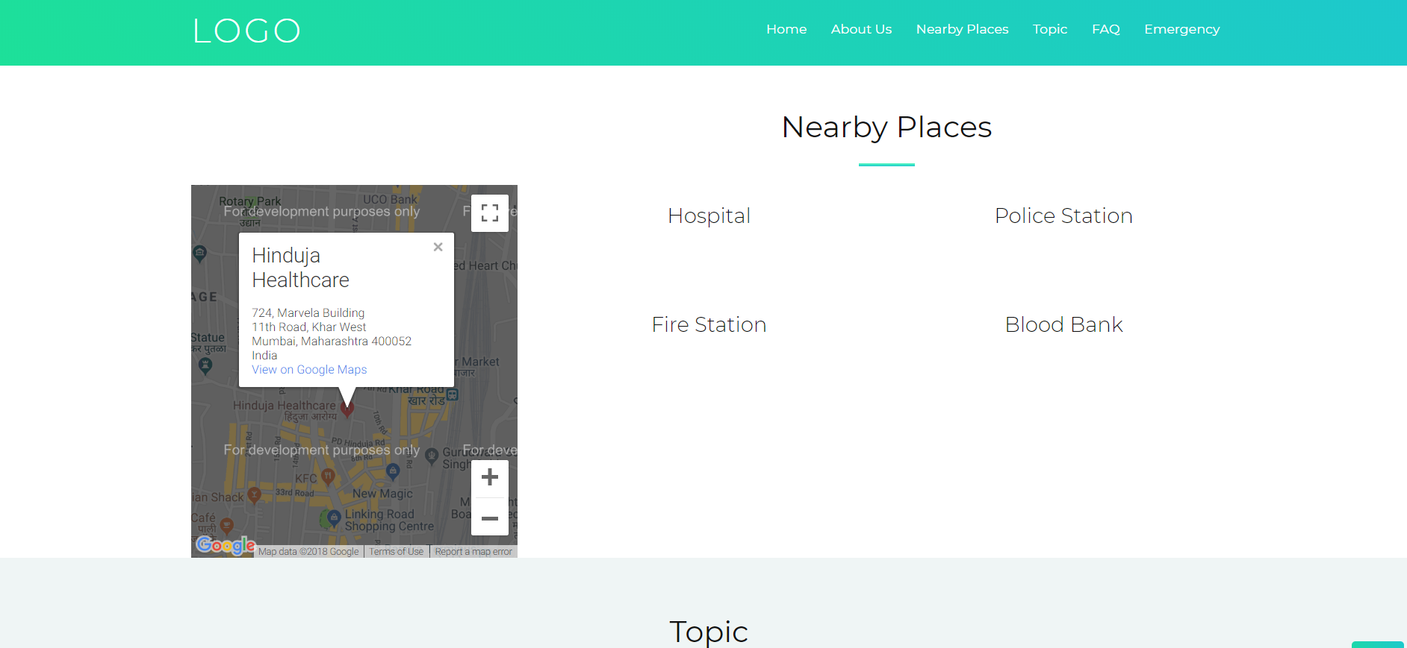
WE, AS DEVELOPERS TRY TO PUT OUR EFFORTS IN MAKING THE USERS LIFE EASY AND EFFICIENT. THUS WE HAVE USED THE BENEFITS OF GOOGLE MAPS, WHICH HELP VICTIMS REACH AND LOCATE THE NEAREST HOSPITAL, FIRE STATION AND OTHER SAFE ZONES.
Web view

Slide 6
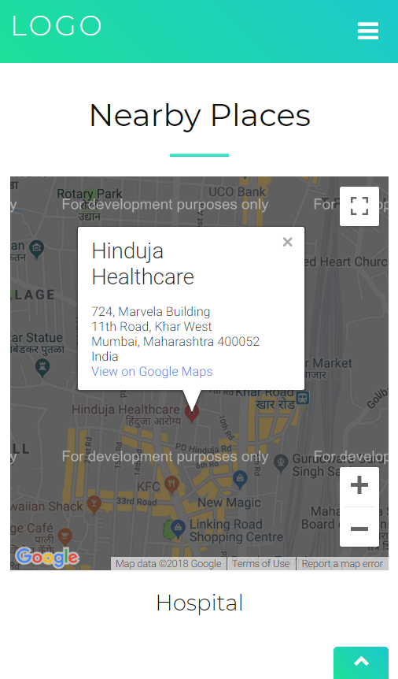
App view

Slide 7
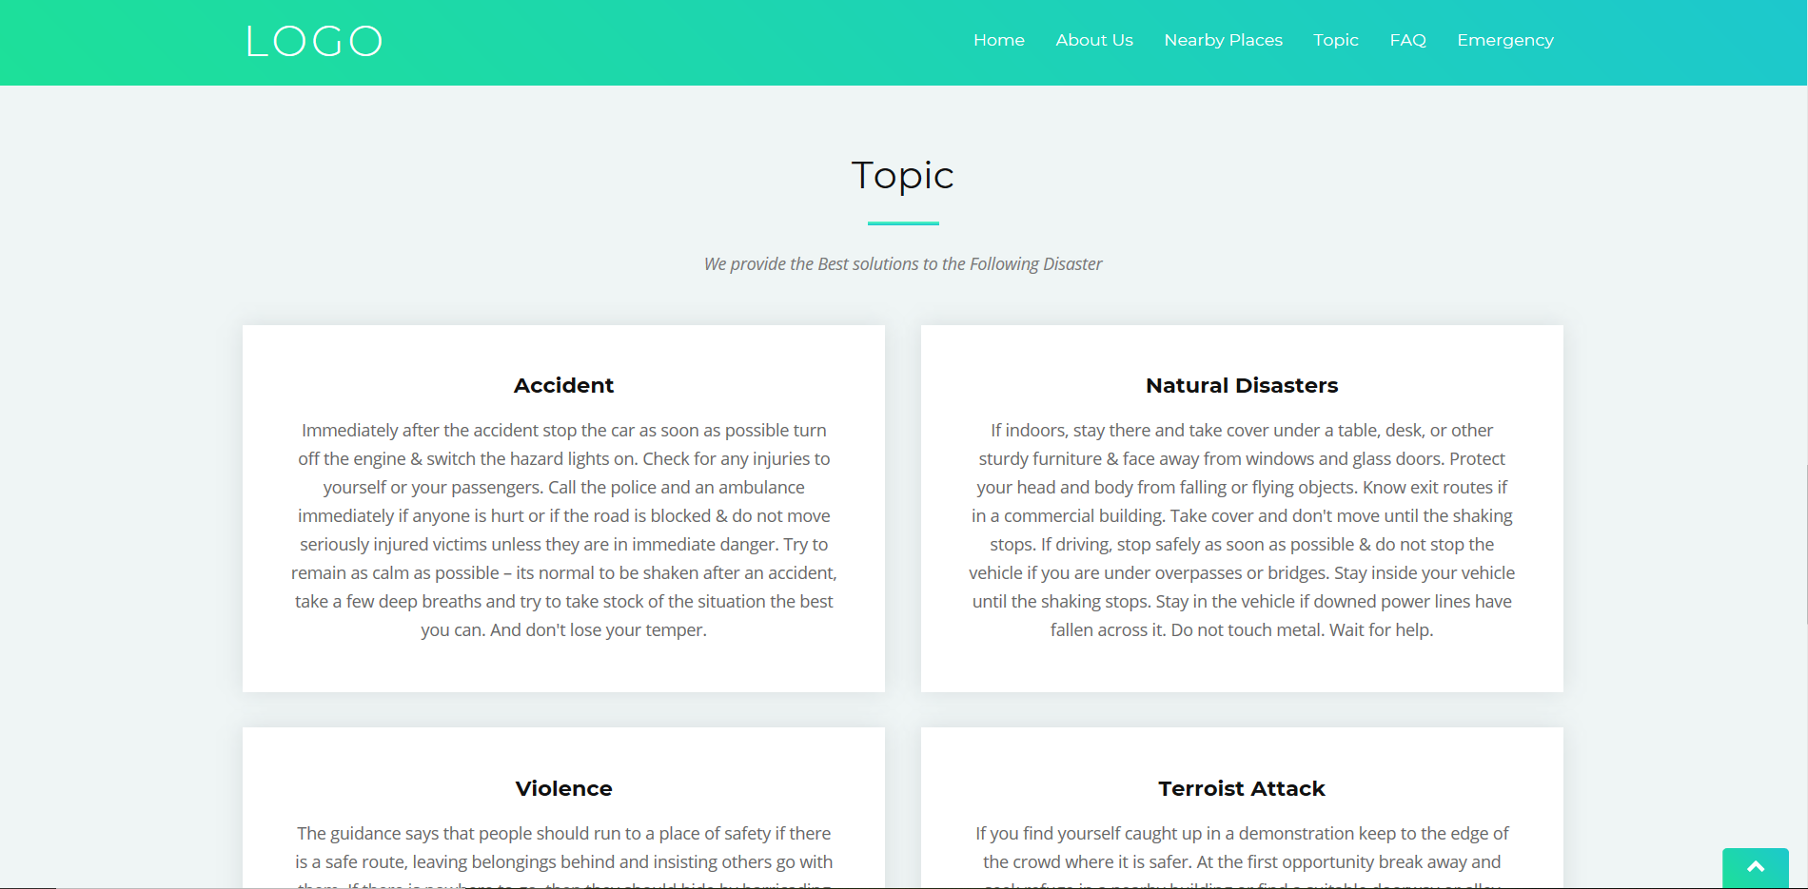
THE VICTIMS ARE ALWAYS IN A STATE OF DILEMA AFTER AN UNPLEASANT EVENT LIKE RIOTS, ATTACKS AND CALAMITIES. HENCE, WE PROVIDE IMPORTANT INFORMATION AND GUIDE THE VICTIMS SUCH THAT WE CAN ENSURE THEIR SAFETY AND WELL-BEING.
Web view

Slide 8
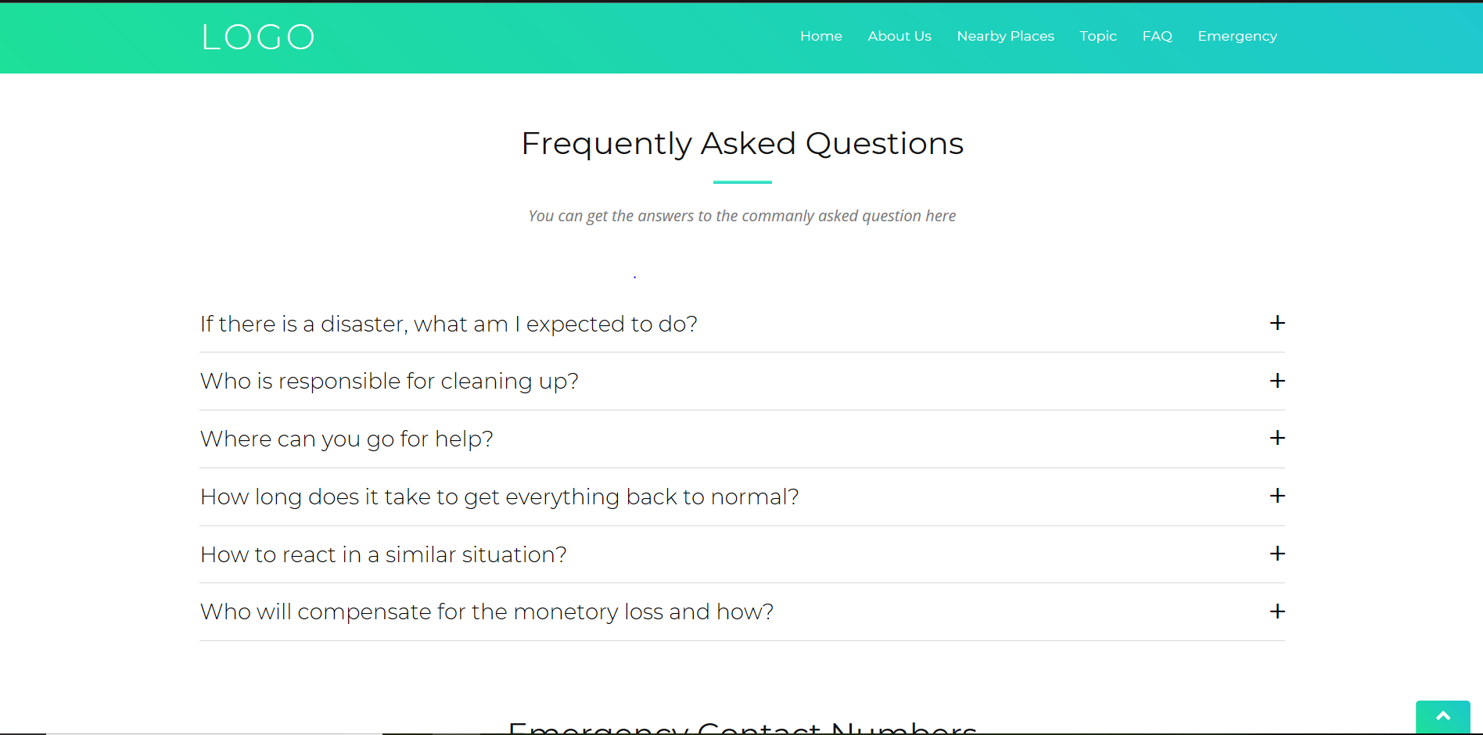
IN CASE THE VICTIMS HAVE ANY DILEMMA OR QUERIES, THEY CAN DEFINITELY VISIT AND CHECK OUT THE WEBSITE FOR MOST COMMON AND FREQUENTLY ASKED TOPICS.
Web view

Slide 9
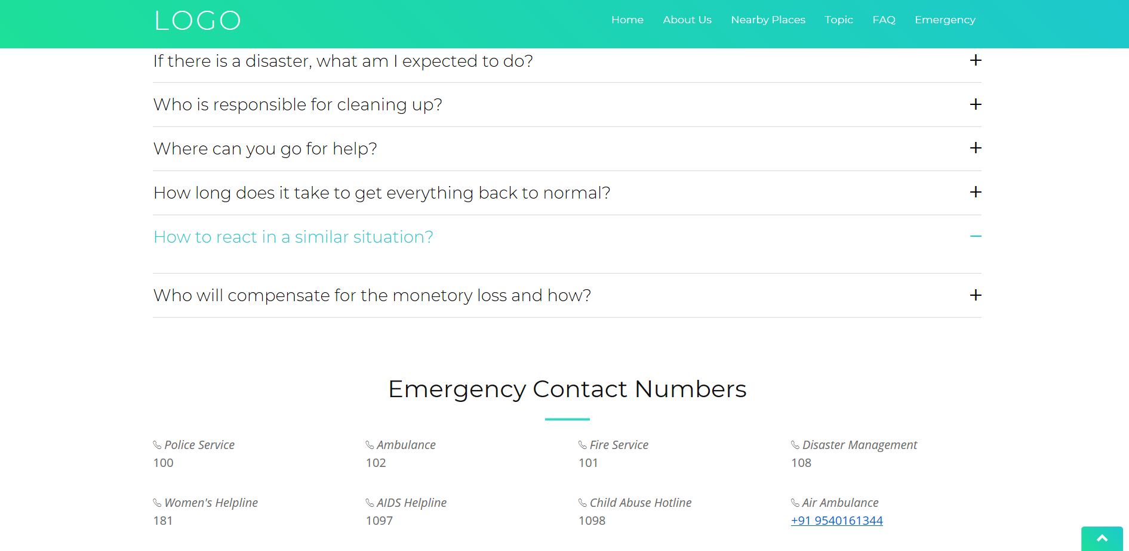
IT IS VERY ESSENTIAL THAT ANY VICTIM OR BY-STANDER HAVE INSTANT CONTACT TO THE NEAREST POLICE STATIONS, HOSPITALS,ETC. THUS THE USER IS PROVIDED WITH THE MOST SIGNIFICANT AND IMPORTANT TOOL- THE EMERGENCY NUMBER.
Web view

